Slide 1
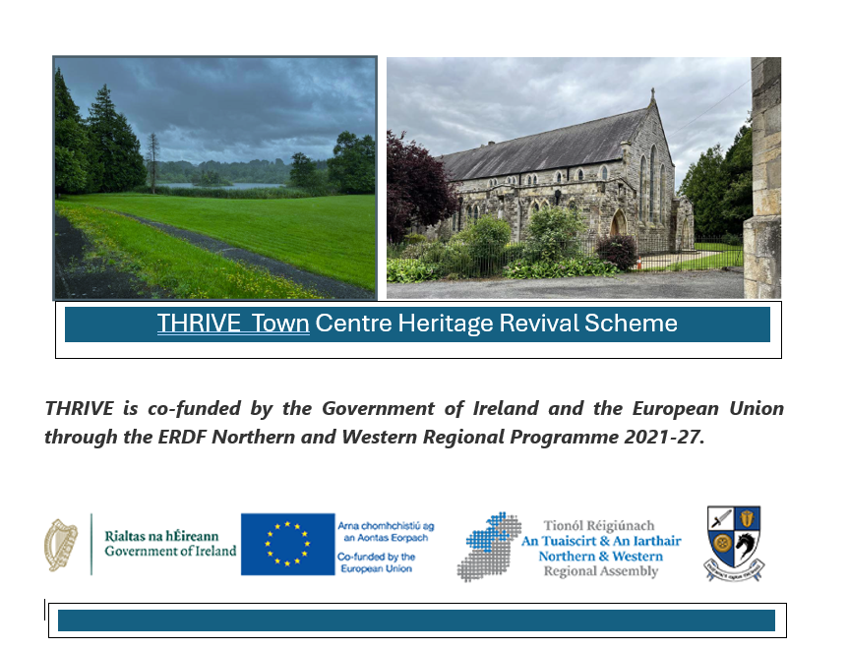


Slide 2
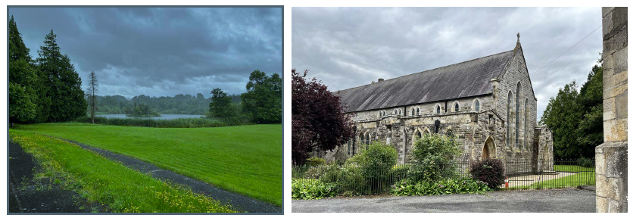

Reimagining Monaghan
Presentation to Monaghan Town Team 15th April 2025 – Outline of Part VIII Application Proposal
Notes:
Members will be aware that an options paper was developed for the buildings and ground on the St Louis Lands by John Mclaughlin Architects. This was noted by members in February.
THRIVE funding Strand 1 funded this initial stage of the project (TcF Plan and the options paper) and there is now the opportunity to secure funding under Strand 2 of THRIVE funding for the reuse of a vacant heritage structure with 100% funding up to the amount of 7million euro.
The Chapel as the predominant building on the site; and as a main attraction for further development on the campus has been identified as project building and to progress this following a tender competition Craftstudio Architects were appointed to develop the building for community/performance/hub for the town.

Slide 3
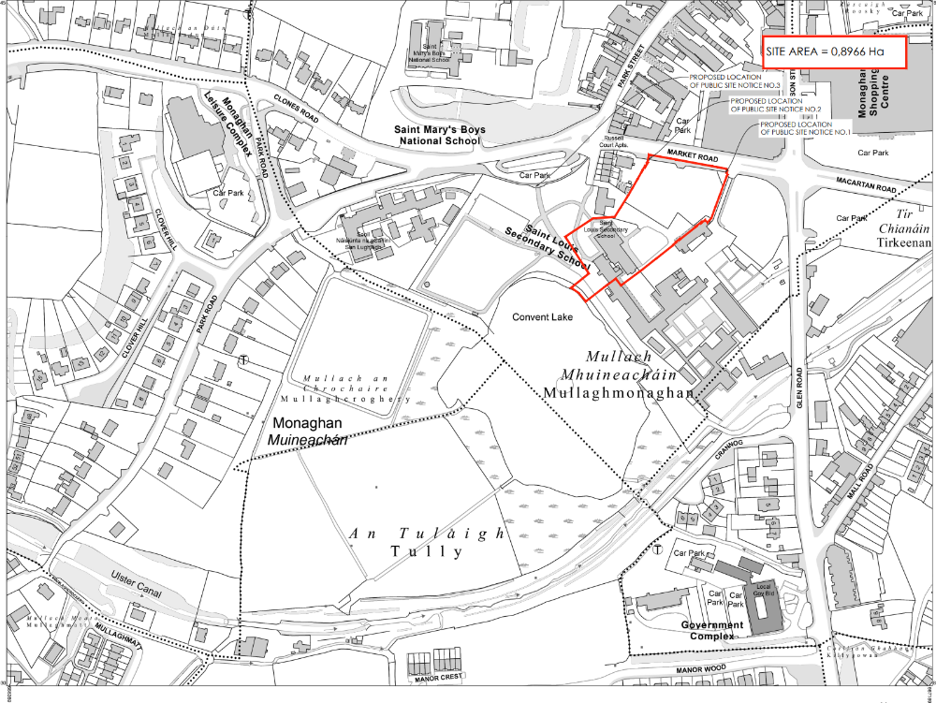
Site Application Area
Red lines shows boundary of Part VIII application for St Louis Chapel application
Notes:
The application is for the Chapel and the carpark area onto Broad Road.
The Former nursing home is included but generally relates to small demolition of some non original flat roof elements between the two buildings.

Slide 4
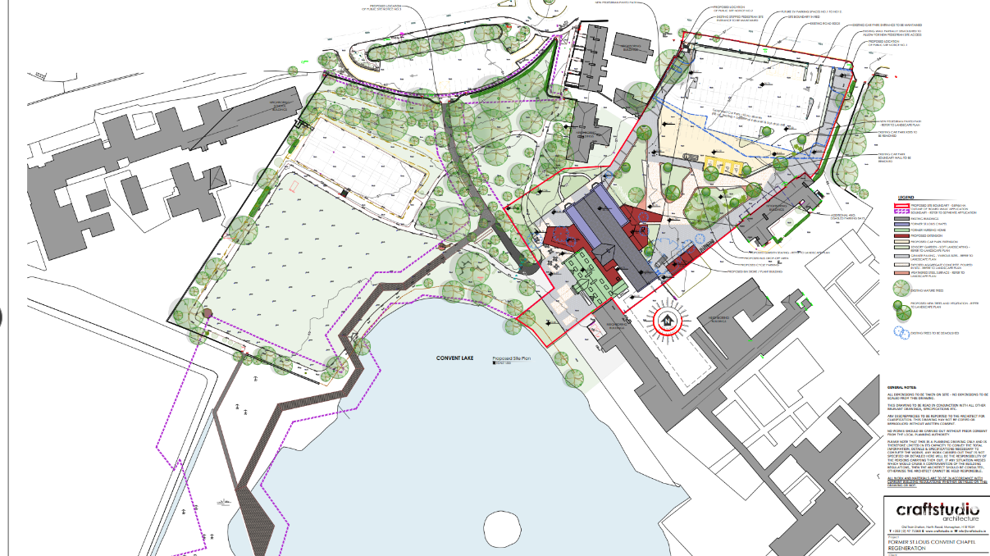
Notes:
As members will be aware this is part of a wider phased development proposal including the grounds of St Louis as well as the buildings.
A concurrent application is being developed to provide for the opening up of the grounds and this will submitted next week. The work involves the repair and renovation of the front walls and gates; improvement to the existing tree lined pathway into the park, introduction of boardwalks (Fully accessible) and development of a amenity spaces

Slide 5
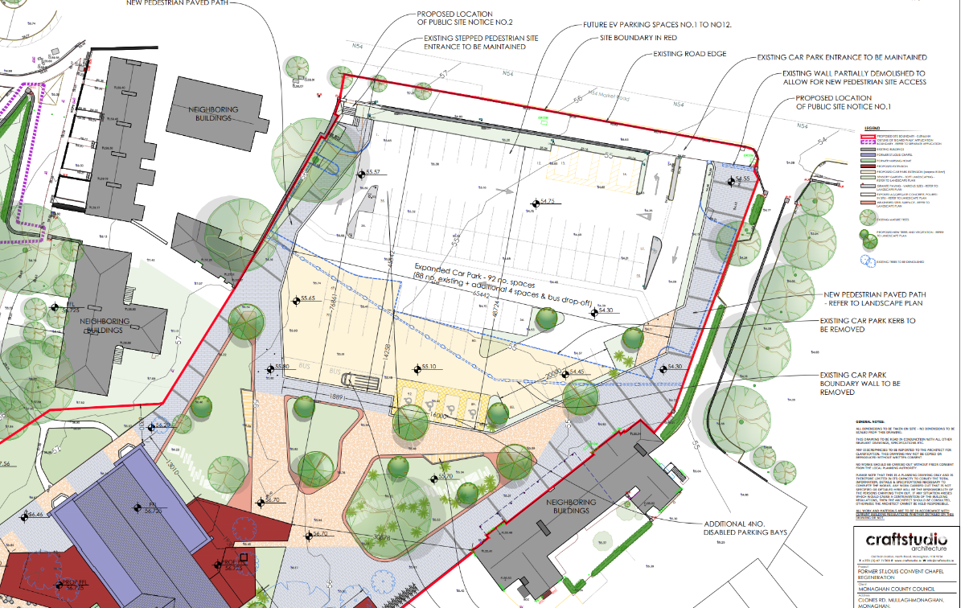
Notes:
For clarity the car park involves utilisation and extension of the car park; incorporation of the existing pedestrian steps to the north west of the site. Formal pedestrian entrance adjoining the existing vehicular entrance to the east
To ensure softening of the car par parking the existing trees have where possible being retained, SUDs incorporated in the layout. Pre planning has been held to ensure certification to allow emergency vehicular access and tender arrangements for the proposed building

Slide 6
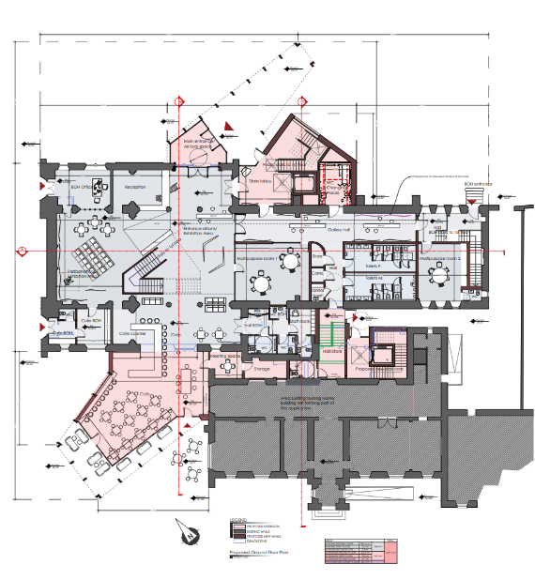
Notes:
The proposal, has developed the main uses identified by the Options study. The proposal incorporates
multi-purpose performance space, event and meeting spaces, exhibition spaces, café, circulation spaces, ancillary welfare and sanitary facilities
The ground floor incorporates 2 main additions ; i) entrance detailing incorporating separate stairwell/lift and changing places toilet ii) glazed café extension to the rear
Intention as set out in the masterplan is to create a destination as part of the greenway; in this regard the café alignment is configured to face the lake onto the greenway and link with the landscape master plan
Once we have the activities on the lake and have the full network of routes through the park then we will have the full complement of uses.
The intention of this development is to allow once addition funding opportunities arise to develop the nursing home and pre plan the linkages so there are two main routes
Through the café
Upper floor through the mezzanine area
Heritage terms
Utilising the stained glass as features upstairs
Retaining the organ upstairs
Integrating the stations of the cross albeit in a slightly different configuration

Slide 7
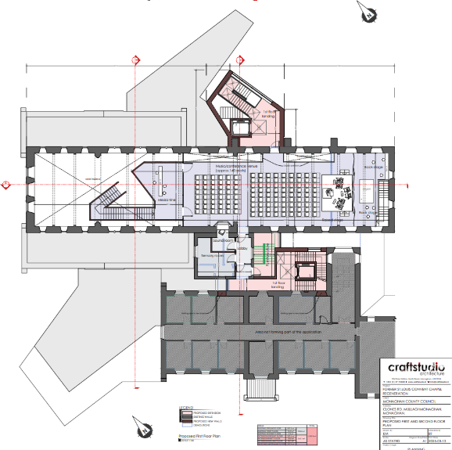
Notes:
Upper floor includes
the addition of a mezzanine floor, to accommodate an event space
Accessible via an internal stairwell and the external stairwell
The layout has been developed to allow for future integration and linkages with the former nursing home
Upper floor to link on that level to provide potential to immediately access smaller rooms on the second floor
Lower level link through the main corridor and also through the café area

Slide 8
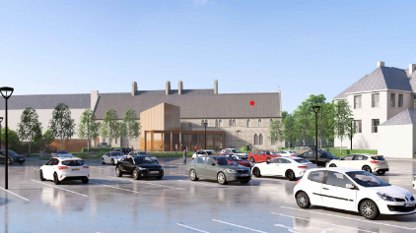
Notes:
These are a number of rendered drawings to give the impression of the proposal
This is the view looking at the church from the Broad Road over the car park – aim as indicated previously is to open up the campus to town; through the introduction of the entrance feature makes the reading of the building easier and adds a bot of interest to its elevation.
Aim was to be a bit subtle hence the lower levels and angular nature of the tower element

Slide 9
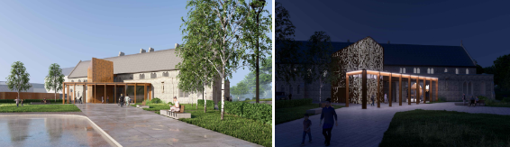
Notes:
Aim of the feature entrance is to reorientate the building to the Broad Road and also provide interest at night/evening.
Through the use of anodised perforated bronze detailing provides this visibility from Broad Road

Slide 10
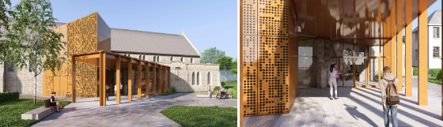

Slide 11
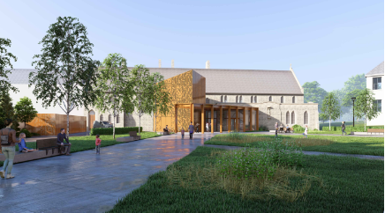

Slide 12
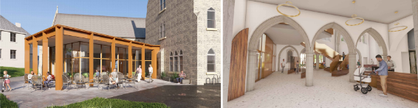
Notes:
The figure to the right is showing the entrance foyer from the cloister providing a general impression of the internal appearance
Image to left is showing the new café addition; composition in the same architectural language as the extension to the front of the building; configured in such a way as to take advantage of the lakeside view as well as the approach from the Skinnader Road roundabout

Slide 13
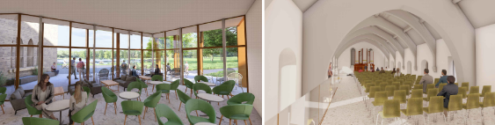
Notes:
View of the internal view from the café
Upper mezzanine area ; laid out for conference/performance – things to note – in longer term this will allow linkage on the upper floors into the nursing home;
Chairs are not fixed thereby allowing further flexibility of the space involved

Slide 14
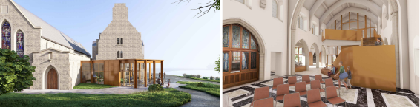
Notes:
Further view of the café addition and its relationship with the gable of the church
Image to right again an internal view from the alter area showing the smaller meeting/talking area and the internal staircase; of note within this picture is the glazed partition between the upper floor mezzanine and the main part of the church thereby allowing separation of uses and control of acoustics

Slide 15
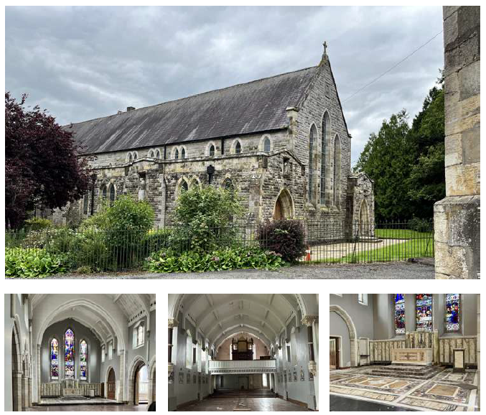
Thank you
Notes:
Due to the criteria set down for the THRIVE funding Strand 2 the Part VIII application has to be approved by the 31 May 2025.
Consequently the application is to be submitted/advertised on Thursday with a 6 week consultation period; intention will be to be present the recommendation at the May full council meeting

